Slide 1

Diamonds price prediction
Done by:
Renad Albishri
Eman Alshehri

Slide 2
Overview
In this project, we are working on a dataset that consists of information about the diamonds and features that price depend on, such as Clarity, Color ,etc.

Slide 3
Goals
Which variables are significant in predicting the price of a diamonds
Build a model to predict the diamonds price.
Choose the model that give us the best predict.

Slide 4
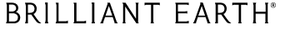
Methodology
Web scraping
EDA
Build Regression
Model
Prediction

Slide 5
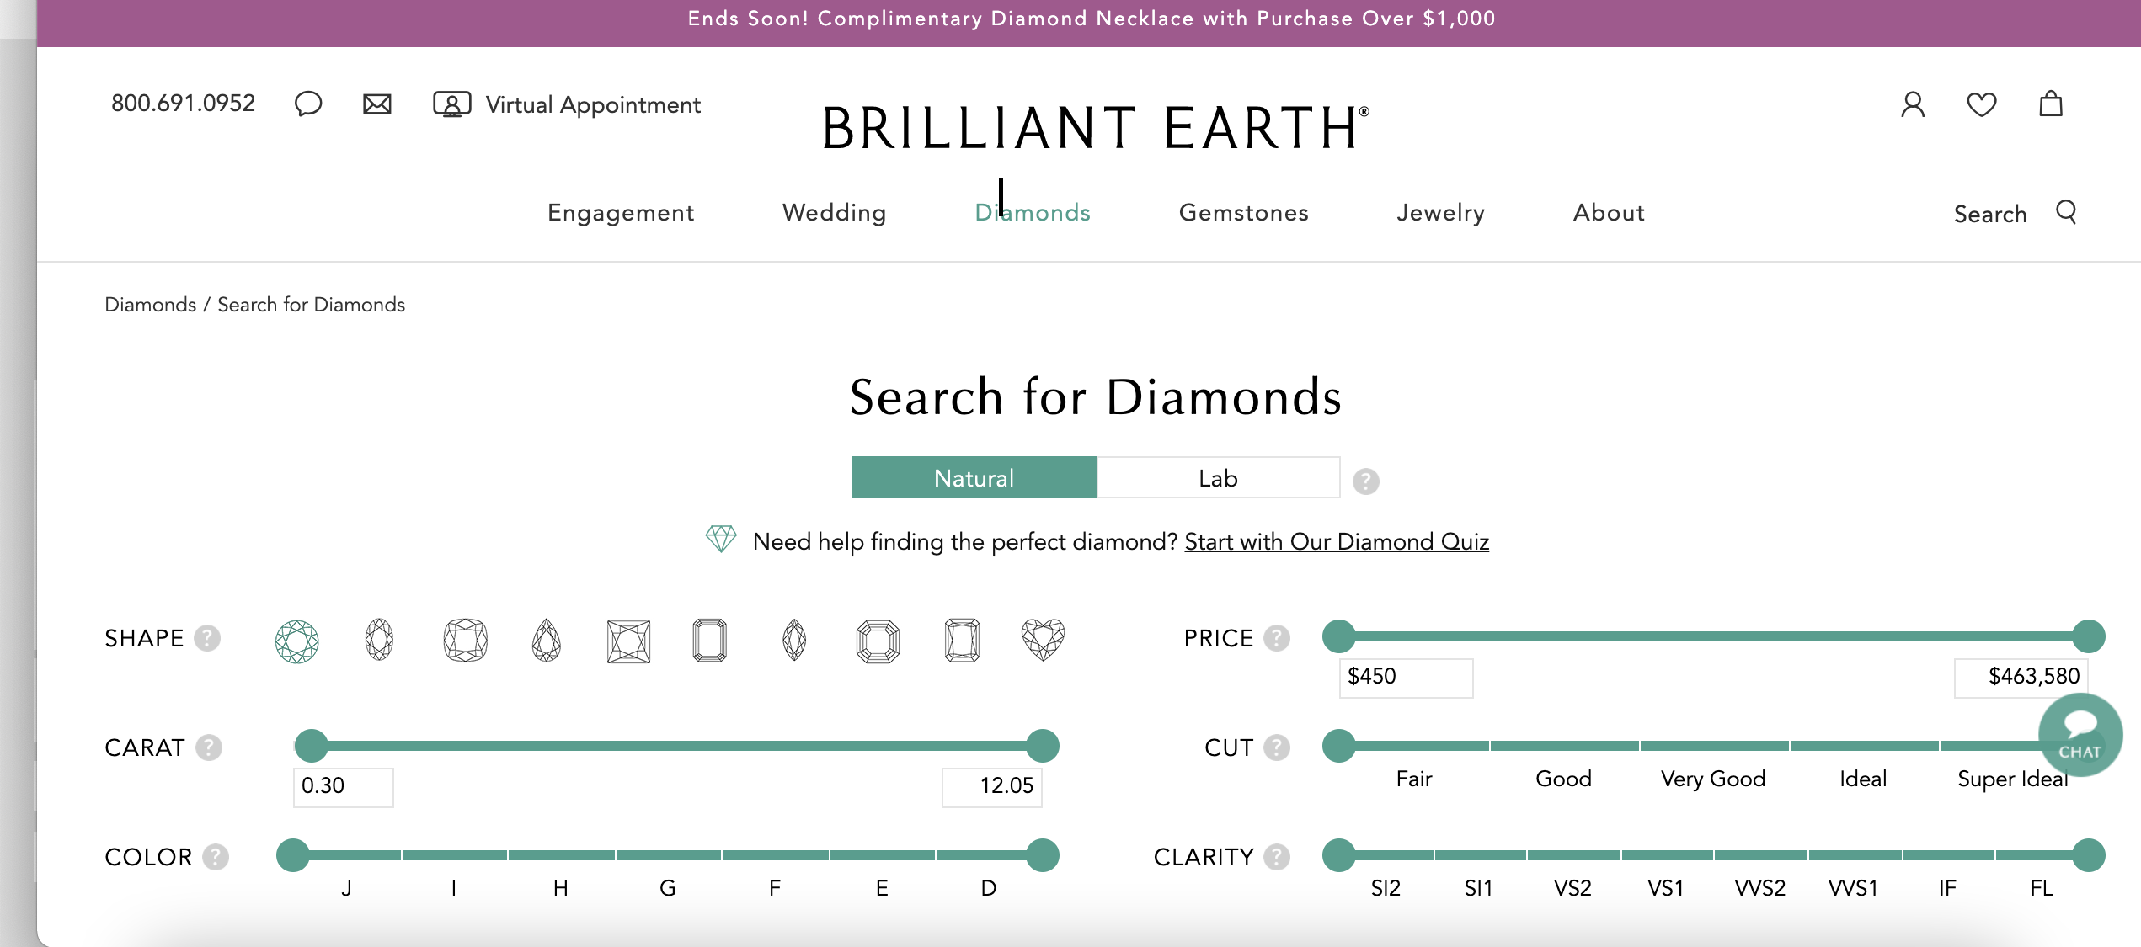

Slide 6
Dataset
The dataset used in this project was obtained by scraping data from brilliant earth(online website) that offers one of the largest collections of diamonds available for sale.
Dataset contains :
119,000 rows
10 features
Id, URL , Shape , Carat , Cut , Color , Report , Type , LW , Price
It's a great dataset for machine learning and working
with data analysis and visualization.

Slide 7





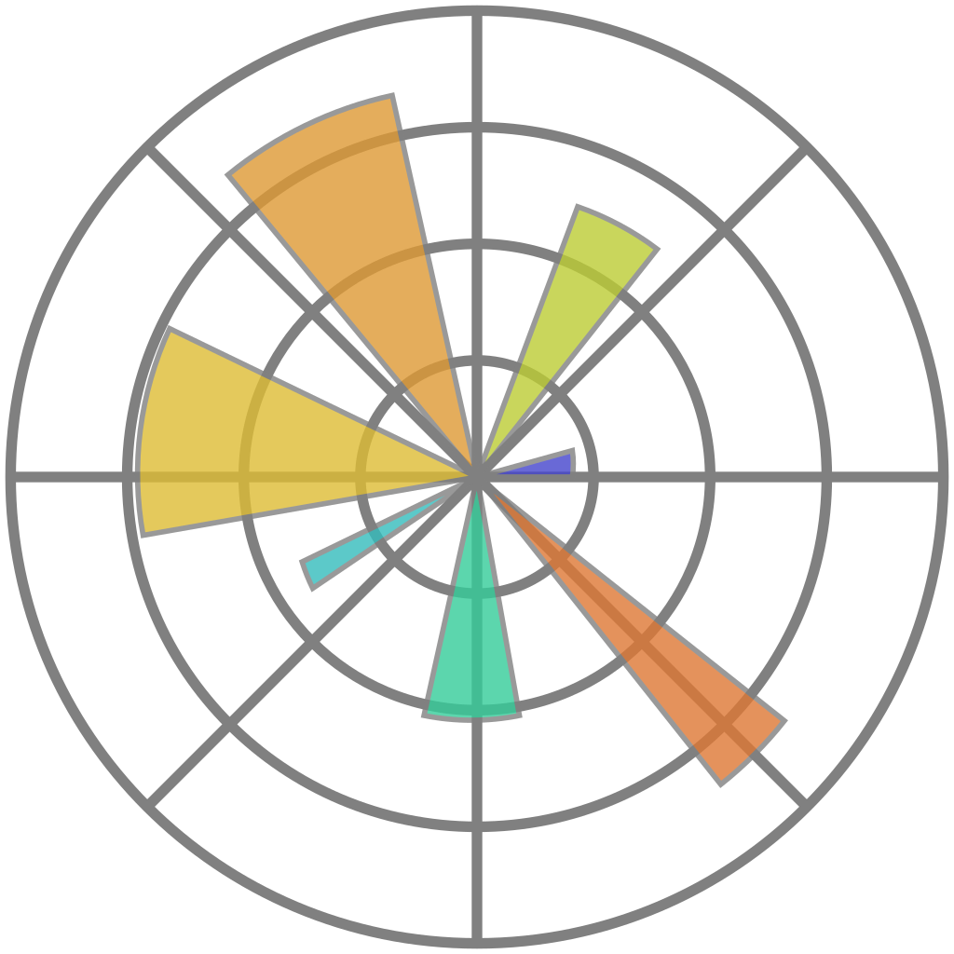


Statsmodels
Sklearn
Pandas
Tools
NumPy
Selenium and beautiful soup
Matplotlib and seaborn

Slide 8
EDA
01
02
Renaming
columns
Drop duplicate
03
04
Check for missing value
-No NULL values
Check for outliers and drop it
05
06
Strip columns
name
Delete unnecessary columns

Slide 9
Outlier
before
After

Slide 10
EDA cont.…
After cleaning the data, the dataset becomes: 65,000 rows 7 features
Clarity
Color
Price
Shape
Carat
Cut
LW

Slide 11
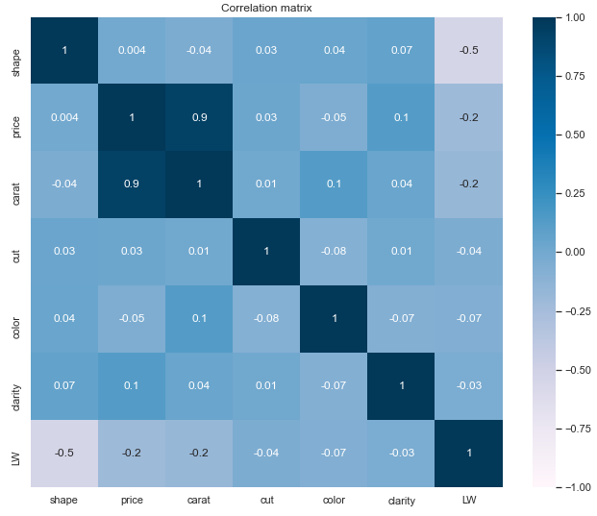
Features and target correlation

Slide 12
Regression and feature engineering
01
02
03
04
Scale data
Encoder
categorical features
Limit the
Price
<25000
Split the data
80% training
10% validation
10% testing

Slide 13
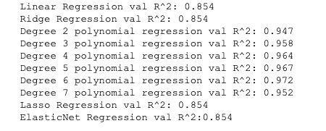
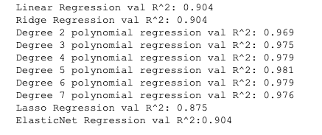
Feature engineering
Before
After

Slide 14
Predicted models
 | R^2 training | R^2 validation
Linear Regression | 0.905 | 0.904
Polynomial Regression degree 4 | 0.977 | 0.979
Polynomial Regression degree 5 | 0.980 | 0.981
Polynomial Regression degree 6 | 0.984 | 0.979
Lasso Regression | 0.875 | 0.875
Ridge Regression | 0.905 | 0.904
Elastic Net | 0.905 | 0.904

Slide 15
Predicted models
 | R^2 training | R^2 validation
Linear Regression | 0.905 | 0.904
Polynomial Regression degree 4 | 0.977 | 0.979
Polynomial Regression degree 5 | 0.980 | 0.981
Polynomial Regression degree 6 | 0.984 | 0.979
Lasso Regression | 0.875 | 0.875
Ridge Regression | 0.905 | 0.904
Elastic Net | 0.905 | 0.904

Slide 16
Selected model
 | R^2 test | RMSE
Polynomial Regression degree 5 | 0.9807 | 0.1413

Slide 17
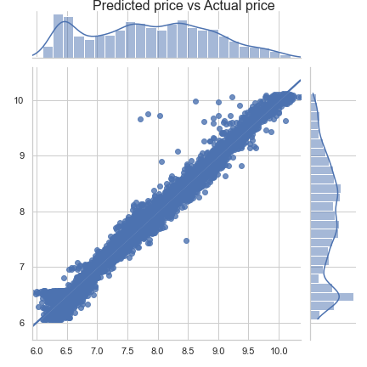
Predicted price
The result of the best model
(Polynomial Regression d=5)
Actual price

Slide 18
Conclusion
Most significant feature in predicting the price of a diamonds is Carat.
The least features affect in predicting the price of a diamonds are Color, LW, and shape.
Selection model to predict diamonds price is Polynomial Regression(degree 5)

